Slide 1

Deep Learning for Surface Defect Detection
Using the NEU Surface Defect Dataset
Presenter: Surya Vamshidhar Buneeti
Instructor: Dr. Chaojiang (CJ) Wu
Date: April 29, 2025

Slide 2

Introduction
• Deep learning has transformed machine understanding of visual and sequential data.
• Advanced models like ViTs, GANs, and CNNs drive breakthroughs in computer vision.
• This project focuses on CNN-based detection of surface defects using the NEU dataset.

Slide 3

Application Focus
• Manual inspection is error-prone and inconsistent.
• Intelligent systems can automate defect detection reliably.
• Aim: Build a CNN model to classify industrial surface defects consistently.

Slide 4

Objectives
• Design and train a CNN to classify six defect categories.
• Apply image resizing and normalization pre-processing.
• Use Kera's flow_from_directory() for efficient data loading.
• Evaluate model using accuracy, precision, recall, F1-score, and confusion matrix.
• Plot learning curves and discuss industrial applicability.

Slide 5

Literature Review - Core Techniques
• CNNs: Strong for structured image classification tasks.
• Autoencoders: Useful for unsupervised anomaly detection.
• GANs: Address class imbalance by generating synthetic samples.
• Vision Transformers (ViTs): Model complex relationships in high-resolution images.

Slide 6

Literature Review - Strengths and Challenges
• Strengths: CNNs achieve >95% accuracy, fast training with transfer learning.
• Challenges: Overfitting on small datasets, explainability issues, high computational cost.

Slide 7

Real-World Applications
• Manufacturing: Automated defect detection improves production quality.
• Healthcare: Deep learning aids in diagnostic imaging like tumour detection.
• Transportation: Road surface inspections for autonomous vehicles.
• Security: Real-time surveillance and threat detection with object recognition.

Slide 8

Dataset Overview
• NEU Surface Defect Dataset: 1,800 grayscale images across six classes.
• Classes include Crazing, Inclusion, Patches, Pitted Surface, Rolled-in Scale, Scratches.
• Data split into training, validation, and testing directories.

Slide 9

Pre-processing Pipeline
• Images resized to 224x224 pixels for model compatibility.
• Grayscale format maintained.
• Normalization applied to scale pixel values to [0,1].
• ImageDataGenerator used for efficient loading and minimal augmentation.

Slide 10

Model Architecture
• Three Conv2D layers with ReLU activation followed by MaxPooling.
• Flattened feature maps connected to a Dense layer with Dropout regularization.
• Output layer uses Softmax activation for multi-class classification.
• Optimizer: Adam | Loss Function: Categorical Cross-Entropy.

Slide 11

Training History
• Rapid early improvement during first few epochs.
• Validation accuracy peaked around 96% before minor overfitting.
• Early stopping applied after 9 epochs to prevent further overfitting.
• Final Validation Accuracy: 91.7% | Test Accuracy: 90%.

Slide 12

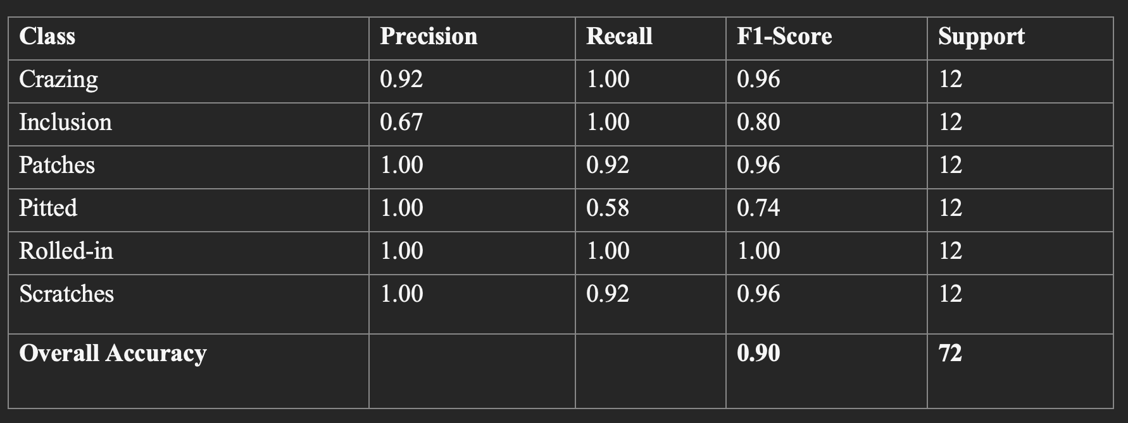
Classification Metrics
• Strong classification performance across most defect classes.
• Perfect precision and recall for 'Rolled-in Scale'.
• Lower recall for 'Pitted Surface' suggests improvement potential.

Slide 13

Observations
• Most classes classified accurately with minimal errors.
• Some confusion between visually similar classes like Pitted Surface and Inclusion.
• Model generalizes well with the given dataset size.

Slide 14

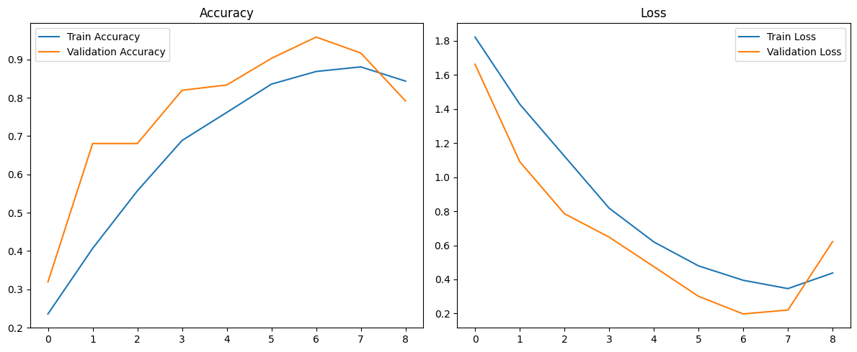
Learning Curves
• Training and validation losses decreased consistently.
• Accuracy curves demonstrate stable and efficient model convergence.
• Minimal gap between training and validation indicates strong generalization.

Slide 15
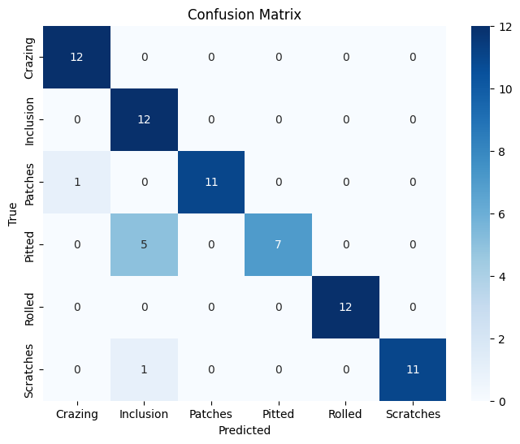
Confusion Matrix
• Strong class separation achieved.
• Pitted Surface defects occasionally misclassified as Inclusion defects.
• Overall low misclassification rate across the test set.

Slide 16

Future Work - Identified Limitations
• Dataset limited in size and defect diversity.
• Deep models act as black-boxes, limiting interpretability.
• High computational cost affects real-time deployment feasibility.

Slide 17

Proposed Improvements
• Use data augmentation and GANs to expand dataset diversity.
• Integrate Explainable AI (Grad-CAM, LIME, SHAP) for transparency.
• Adopt lightweight CNN architectures like MobileNet.
• Explore edge-cloud hybrid solutions for faster real-time inspection.
• Implement online learning to allow models to adapt over time.

Slide 18

Conclusion
• CNNs can accurately detect surface defects with ~90%+ accuracy.
• Results validate the use of deep learning in industrial quality control.
• Scaling datasets, improving model explainability, and optimizing for real-time use are key.

Slide 19

References
• Research papers on CNNs, GANs, Vision Transformers.
• NEU Surface Defect Dataset utilized for evaluation.

